Slide 1

Seminar On Simple
Scanning ,Creating PDF and Forwarding App from Android

Slide 2

How to scan the document by
using CSCamScanner app
from android mobile and
send it to another destination
through Email &Whatsapp

Slide 3
Steps as follows

Slide 4
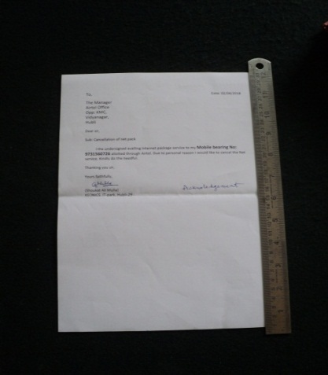
Step 1
Keep the document to be scanned as shown in fig 1

Slide 5
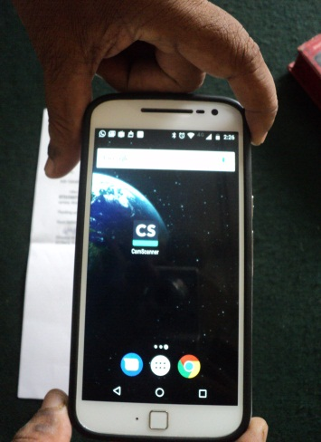
Step 2
Open the CS Cam Scanner app from your android mobile
and hold horizontally on the document to be scanned

Slide 6
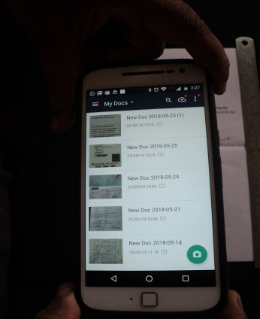
Step 3
After opening the Cam scanner it appears as in the figure,
now press the green button at the bottom right corner.

Slide 7
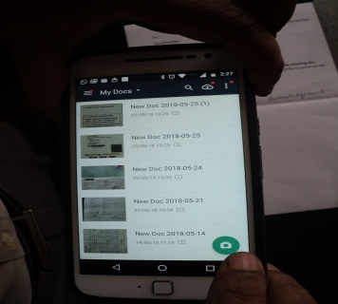
Step 4
Pressing the green button

Slide 8
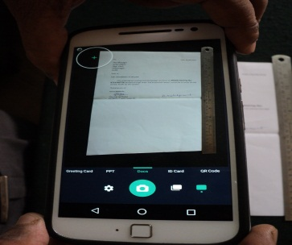
Step 5
Adjust the mobile screen for clear and sharp picture of the document

Slide 9
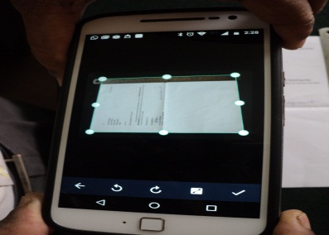
Step 6
Now you can set the borders of the document as appearing in the screen

Slide 10
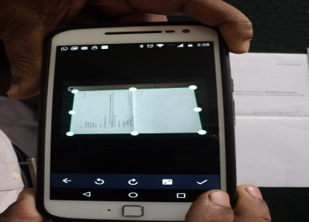
Step 7
Now press “ Pass marked” right bottom corner button as shown in the figure

Slide 11
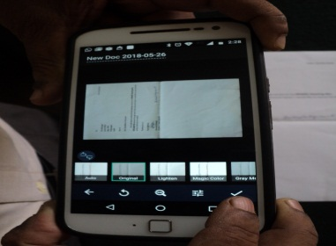
Step 8
Original frame selected will appear automatically. Now once again press “ Pass marked” right bottom corner button as shown in the figure.

Slide 12
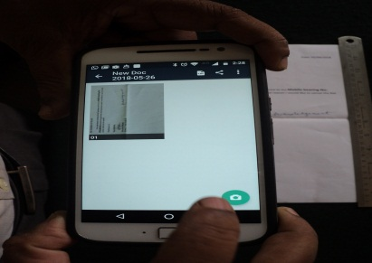
Step 9
Press the green button

Slide 13
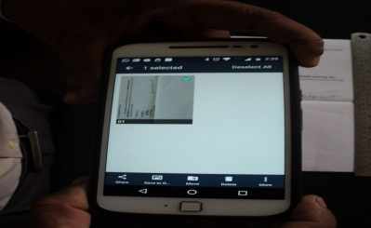
Step 10
Many options will open at the bottom of the screen

Slide 14
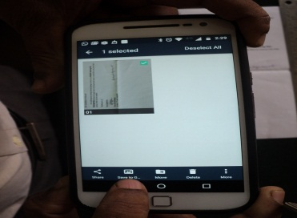
Step 11
Press on the “save to gallery button

Slide 15
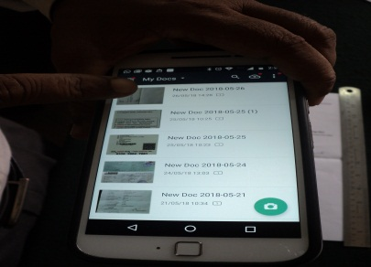
Step 12
You can see the scanned copy of the document on the screen

Slide 16
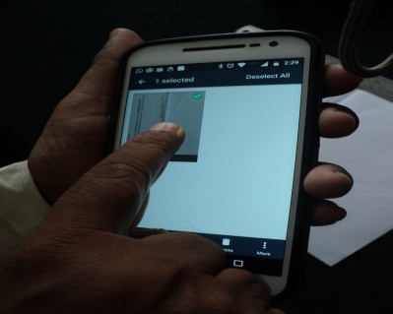
Step 13
Now press and hold on the document for sending through
“Email” or “whatsapp”

Slide 17
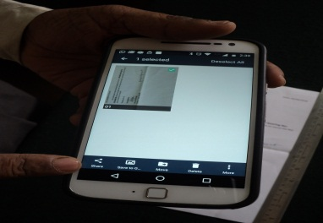
Step 14
You can see the document selected

Slide 18
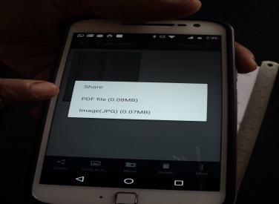
Step 15
Select the “PDF File”

Slide 19
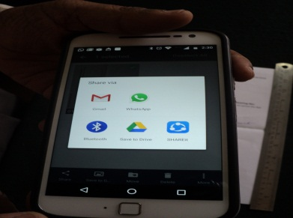
Step 16
Now you can see the “Mail” and “Whatsapp” Icons
on the screen

Slide 20
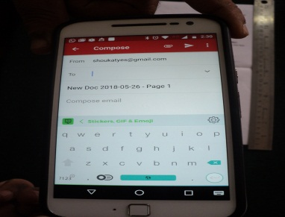
Step 17
Screen appears like this when “Email” Icon is pressed,
type the email address, subject and matter in the compose window.

Slide 21
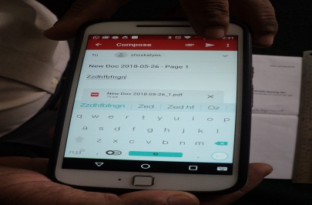
Step 18
Here you can see the attached document in “PDF format” and press on the arrow marked button as shown in the figure, document will be sent through email.

Slide 22
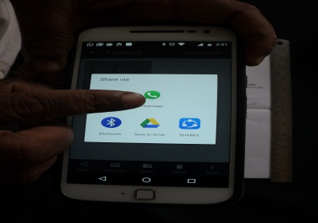
Step 19
If you want to send to Whatsapp, refer point no 16, press on Whatsapp icon

Slide 23
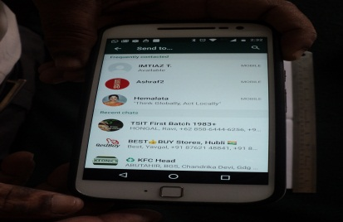
Step 20
Whatsapp window will open and you can see the list members in whatsapp or search the person by pressing search button to whom you want send the document

Slide 24
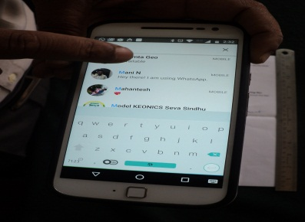
Step 21
press on the name of the person you want send the document

Slide 25
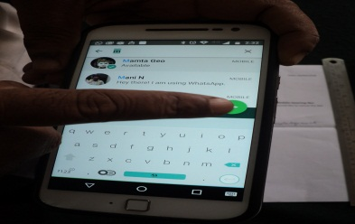
Step 22
Press on the green Arrow mark, document will be sent to that person

Slide 26
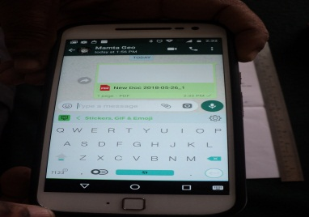
Step 23
Now you can see the document attached, If you want you can type the matter in the matter box

Slide 27
THANK YOU

